Slide 1

Holistic Business Assessment

Slide 2
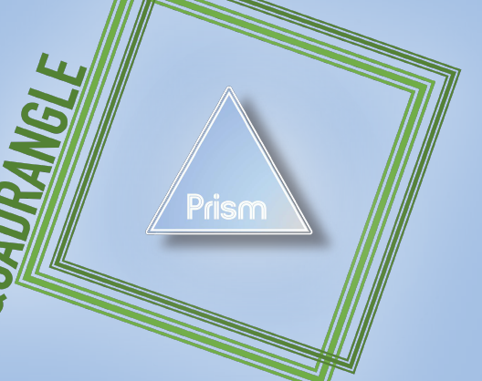
Mission
Aggressively accelerate Prism’s growth
Notes:
Qaudrangle’s mission is to aggressively grow successful businesses.
From this we can assume that the growth needs to be rapid and significant and this assessment will showcase the areas that need improvement and ways in which you can do so

Slide 3

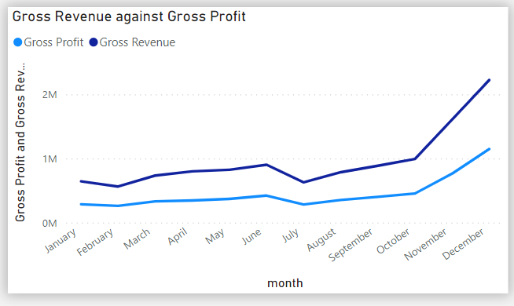
Overview of the business
Sales have increased by +122% to 401K in 2022
Gross profit has increased by +241% to £5.42 million in 2022
Our highest performing months are October to December

Slide 4


Product
Average Order Value
Customers are spending £12 more compared to 2022
AOV increasing by +47% YoY
Return Percentage
Over a quarter of our orders have involved a return (28%)
Notes:
For this, we could introduce a size guide for all of our products, with added descriptions such as true to the size, oversized etc.
Tailored product recommendations
Cross Selling, Up-Selling
Increase profit margin by renegotiating current shipping costs and payment process servers
Minimum order incentives (Once again we know what the average order value is. We can benchmark 3-7 pounds above that in order to offer free shipping)
Also offer bundles as our units per transaction are low
Poor performing products that are not related to fashion should be discontinue of because we want to become the global leading fashion retailer not a retailer.
Shoes bags, suits, tops, outerwear, bottoms, cosmetics, make up accessories and beachwear. These are all fashion items. Comparing it to our low profit home & decoration which is not relevant to fashion, we are better off discontinuing the line. I am not sure if this is the right way of saying it but to be honest, we are a fashion retailer and if we are not fully focused on that category, we are kinda running with weights on us.
When it comes to cross-selling, the item that is being suggested should be no more than 20-30% of the original item added to cart.
Cross selling can introduce users to products they were unaware you offered, increasing their trust in you as the best retailer to meet a specific need.

Slide 5
Web
Engagement Rate
Engagement rate is 83% in 2022 compared to the industry average of 63%
Conversion Rate
Our 0.62% website conversion rate is significantly below the industry average of 1.8%
Continuation Rates
Only 6% of customers who have viewed an item are adding it to their cart and 88% of customers are abandoning their carts.
Notes:
Not the most accurate measure to look at. It is cause by the increase in the number of website visitors while the number of purchases did not seen the same significant increase.
Sad face happy face
Funnel as the visualisation
Observations regarding the visuals and kpis
Mention the recommendations
For this, we could introduce a size guide for all of our products, with added descriptions such as true to the size, oversized etc.
One other thing that we could do, is have customers offer ratings for our products so that our new customers can have a grasp of what our best products are.
Talk about conversion rate as key result indicator and talk how

Slide 6
Marketing
Registered customers
We have doubled the number of registered customers since 2021
67% of our revenue come from registered customers in 2022
Retention Rate
32% of our registered customers have come back to shop with us in 2022
Notes:
Through our marketing campaigns, we made 15 mil pounds in 2022.
Out of those 15 million, 677 thousands came from meta, while the majority of it came from google to an astonishing 10 mil pounds.
Another interesting fact is that when it comes to google, visits from mobile and desktop seem to be equal. However, when we look over to meta, we can see that the majority come from mobile, while desktop has a really poor engagement.
For the purpose of this presentation, I wanted to provide at least a ball park in terms of how these costs would look like in the real world.
Meta has generated 30 million visits out of the total of 65 that happened in 2022. That is almost half of them, and yet those customers perform the worst on our website.
In a real world, it costs around 12 dollars per 1000 impression in order to use meta ads. If we were to do a quick calculation. We can say that this costed our company around 360 thousand pounds while it generated 720,000. This doesn’t sound too bad if we think about the fact that we have double our investment, however, this is nothing compared to google.
Google amounts to around 23 million visits. Once again, doing the calculation, it costed us I think like 276 thousand but it generated us 10 million. I believe that we should maintain our focus in the google ads
Tradedoubler is another good one tho. So basically they account for only 260,000 visits but they generated us 324k. I believe
Increase opt-ins

Slide 7
Customer
Customer Value
The average amount a customer has spent over a year has increased by £24 since 2021 (+60%) to £64
Units per Transaction
The average number of items customers have bought is unchanged since 2020 (1.6 per order)
Notes:
Mention the funnel chart with Penelope see what she thinks about it
If she doesn’t agree, follow the narrative for the customers divided by city
Vaguely talk about and request additional information for a better customization of our recommendations and offers
Retention rate
Ony 4,8

Slide 8
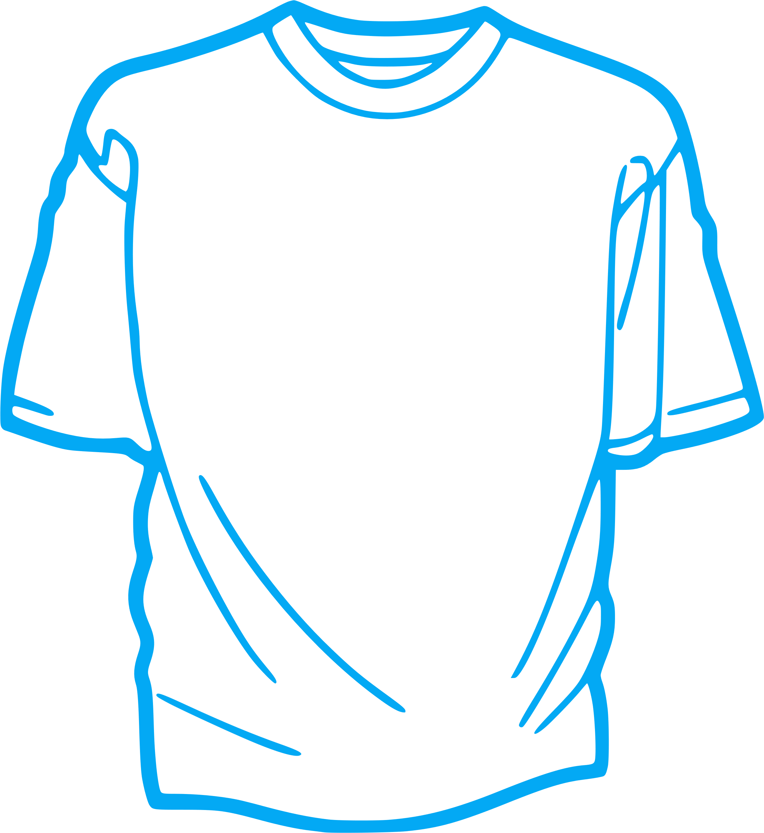


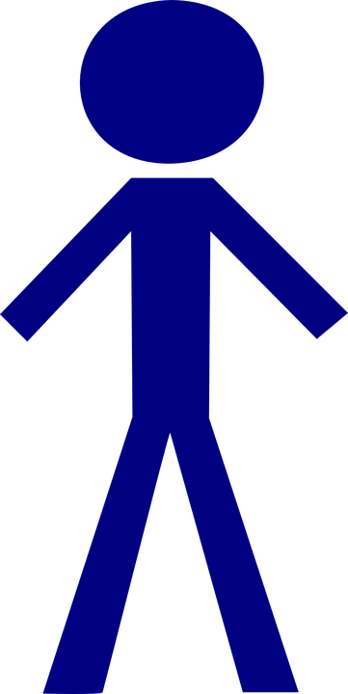
Action Plan
Product
Improve return percentage through the introduction of a size guide
Increase AOV through the introduction of minimum order incentives
Web
Improve our funnel continuation rates by a better optimization of the user journey
Introduction of a ratings and review section
Marketing
Review our current marketing campaign for meta and devise a budget strategy
Increase customer retention rate by adding a blog section on our website
Customer
Personalise web and marketing through customer segments
Offer coupons upon creation of the account
Increase UPT by offering bundles

Slide 9
On to the Dashboard

Slide 10


Slide 11
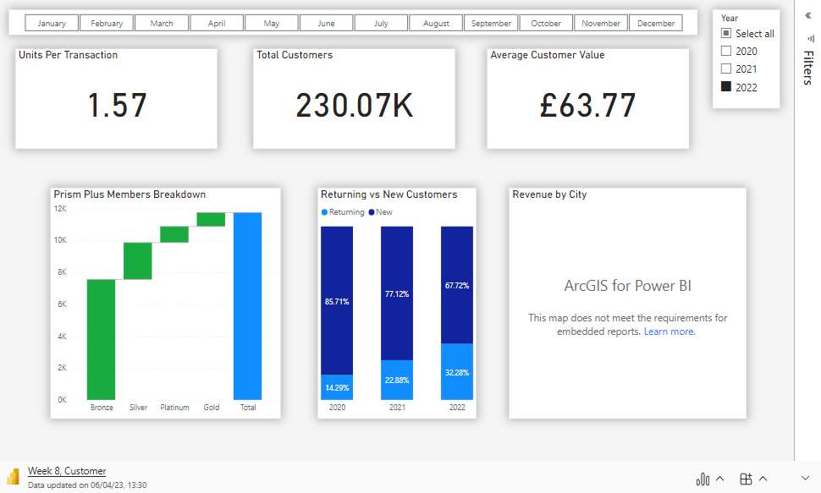

Slide 12
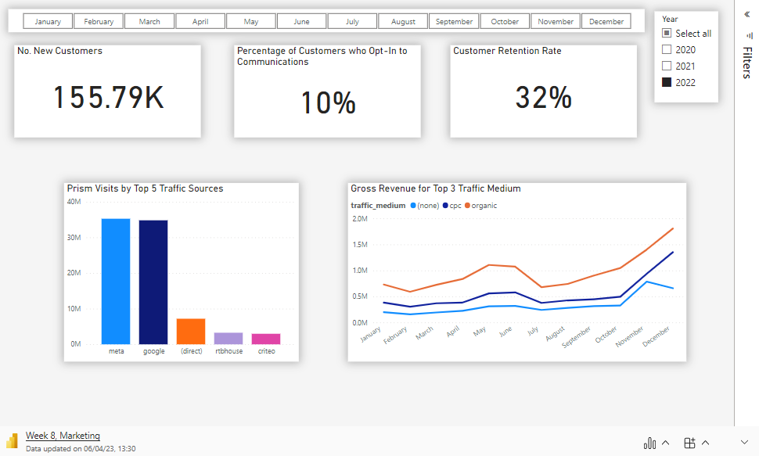

Slide 13
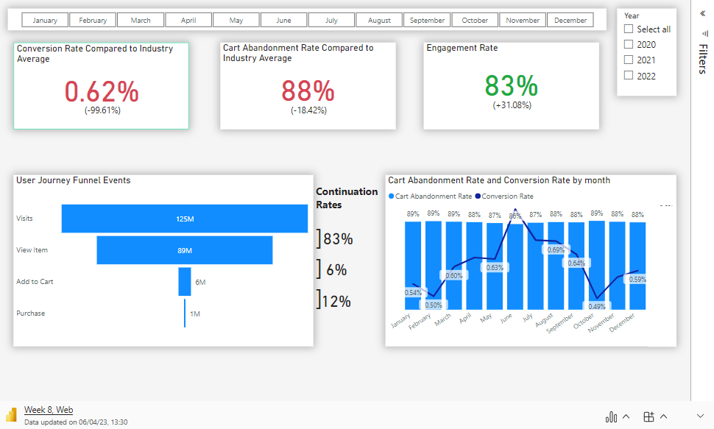

Slide 14
